Slide 1
Applied Data Science Capstone Project
Submitted By
Paras Dhama

Slide 2
Introduction:
United states have a long history of immigration which includes New York as well. It is one of the most densely populated cities in the country and consists of people from different backgrounds and ethnicities. This city has been the favourite destination for immigrants as it offers a wide variety of options for people when it comes to food and job opportunities.
“As many as 800 languages are spoken in New York, making it the most linguistically diverse city in the world. English remains the most widely spoken language, although there are areas in the outer boroughs in which up to 25% of people speak English as an alternate language, and/or have limited or no English language fluency. English is least spoken in neighbourhoods such as Flushing, Sunset Park, and Corona.”
The city has lots of restaurants when it comes to food habits and satisfying its people. Hence, my problem statement revolves around the Indian restaurants in New York city.
Notes:
Insert a map of your country.

Slide 3
Problem:
To find the answers to the following questions:
Q1) Figure out the parts of New York city that has Indian restaurants?
Q2) Find out good locations for Indian cuisine?
Q3) Find the potential Indian restaurant market?
Q4) Find the areas that lack Indian restaurants and can be used to open one?
Q5) which is the best place to stay if you prefer Indian Cuisine?
Notes:
Insert a picture of one of the geographic features of your country.

Slide 4
Data Section:
For this project we need the following data:
New York City data that contains list Boroughs, Neighbourhoods along with their latitude and longitude.
  Data source : https://cocl.us/new_york_dataset
  Description: This data set contains the required information. And we will use this data set to explore various neighbourhoods of New York City.
Indian restaurants in each neighbourhood of New York City.
  Data source : Foursquare API
  Description: By using this API we will get all the venues in each neighbourhood. We can filter these venues to get only Indian restaurants.
GeoSpace data
  Data source : https://data.cityofnewyork.us/City-Government/Borough-Boundaries/tqmj-j8zm
  Description: By using this geo space data we will get the New York Borough boundaries that will help us visualize choropleth map.
Notes:
Insert a picture illustrating a season in your country.

Slide 5
Methodology:
1. I collected data from the new York city website "https://cocl.us/new_york_dataset"
2. I found all venues for each neighbourhood using Foursquare API
3. Now I found the ratings, Tips and number of likes by using a Foursquare API. Hence, I found the entire data for Indian restaurants
4. sorted Neighbourhoods and Borough the data keeping Ratings as the constraint.
5. Then all the ratings greater than equal to 9 are shown on map.
6. Then the final data sets are merged
7. we will visualize the Neighbourhoods and Borough based on average Rating using python’s Folium library.
Notes:
Insert a picture of an animal and or plant found in your country.

Slide 6
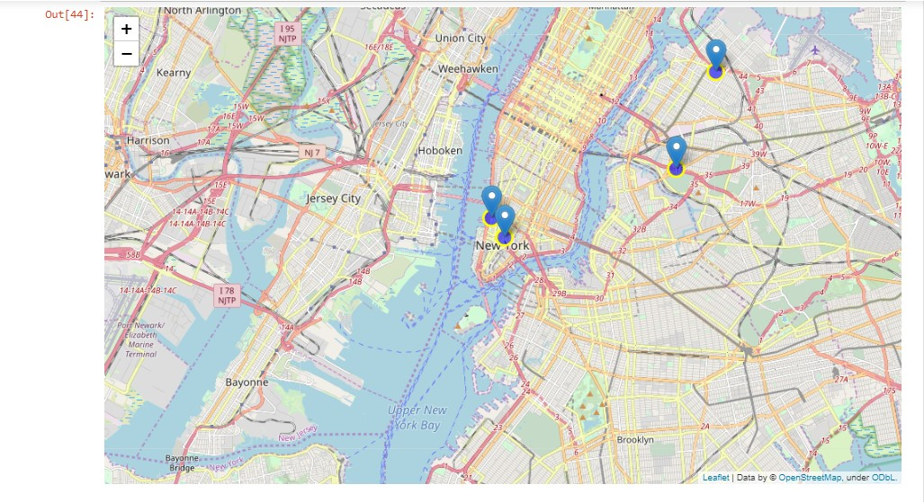
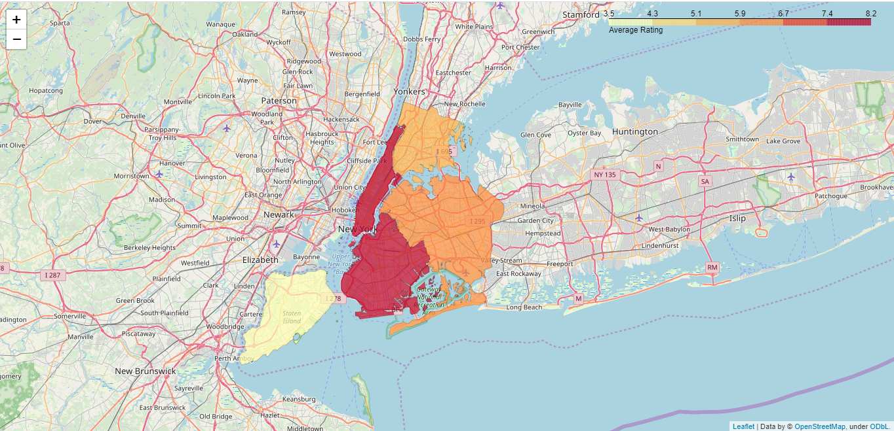
Images
Neighbourhoods based on average rating
Borough based on average rating

Slide 7
Conclusion:
So now we can answer the questions asked above in the Questions section:
Answers:
The following location in New York City has great Indian restaurants.
Astoria (Queens), Blissville (Queens), Civic Center (Manhattan) are some of the best neighbourhoods for Indian cuisine.
Manhattan have potential Indian Restaurant Market.
Staten Island ranks last in average rating of Indian Restaurants.
Manhattan is the best place to stay if you prefer Indian Cuisine.
Notes:
Add key points in the history of your country to the timeline.

